Slide 1
HomeWork 1 by aimeric rouyer
ID : 414410902
Consign :
Setup Ubuntu Desktop and Ubuntu server
Execute a list of command in a terminal
Show the result of thoes command
Explain what are their functions
The commands are : cd, ls, chown, rm, cat, ifconfig, vi, vim, nano, sudo, ps, kill, apt, wget, grep, source, service

Slide 2
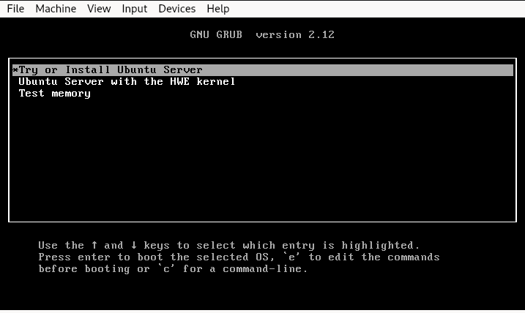
Part 1 setting up ubuntu Server
First we have to specify what we want to do with the iso ( install ubuntu in our case )

Slide 3
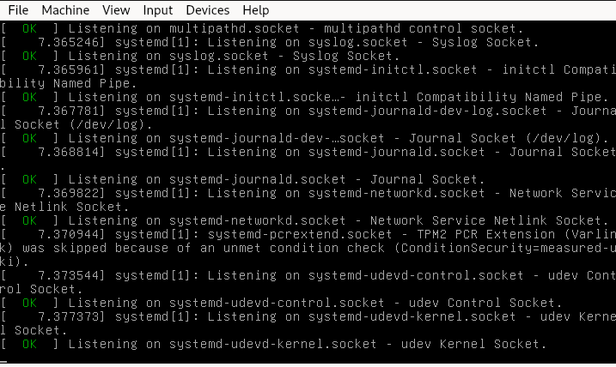
Part 1 setting up ubuntu Server
Some lines of code will be shown here you have to wait

Slide 4
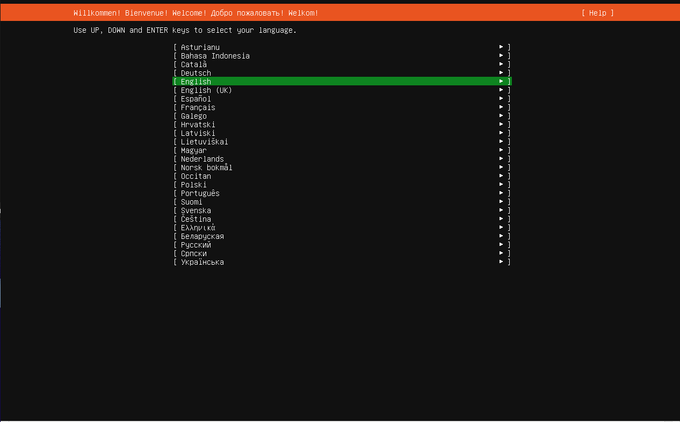
Part 1 setting up ubuntu Server
First we will select the language to do that use the arrow on our keyboard and then press enter when the green line is on the correct language

Slide 5
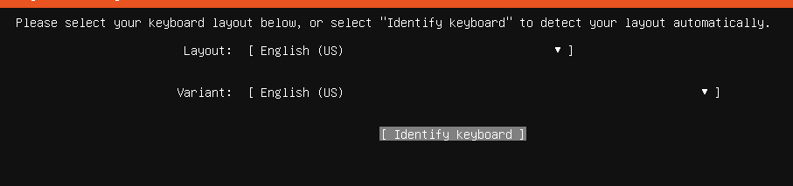
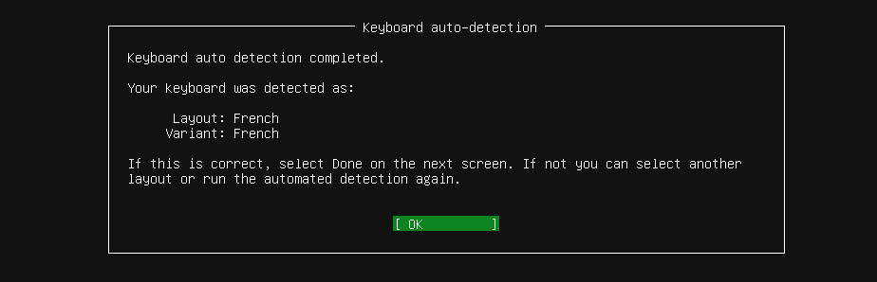
Part 1 setting up ubuntu Server
Now we will have to configure the keyboard i recommendd to sleect identify keyboard and press enter
It will ask you to press key and question about wether or not key are present on your keyboard

Slide 6
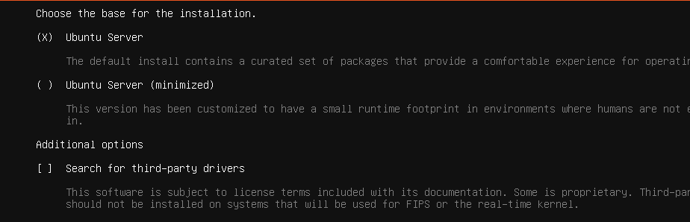
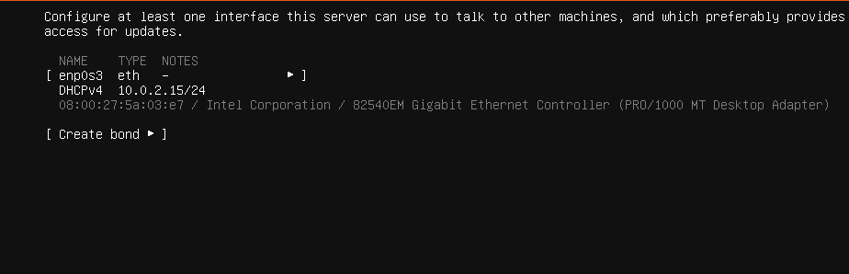
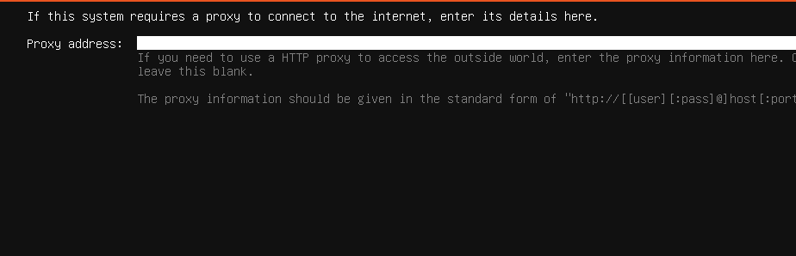
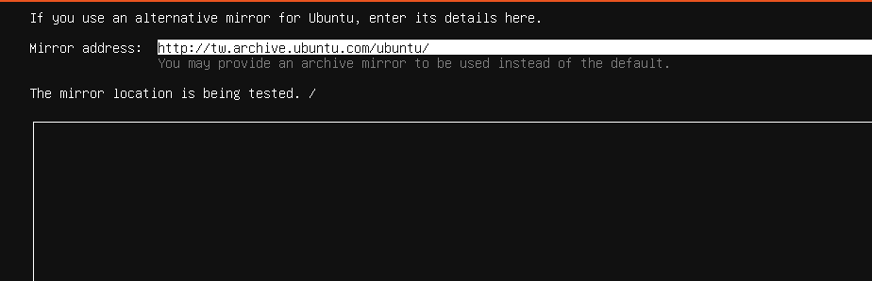
Part 1 setting up ubuntu Server
Here it will ask us a series of questions, for the default config like ours we don't have to modify this simply press enter

Slide 7
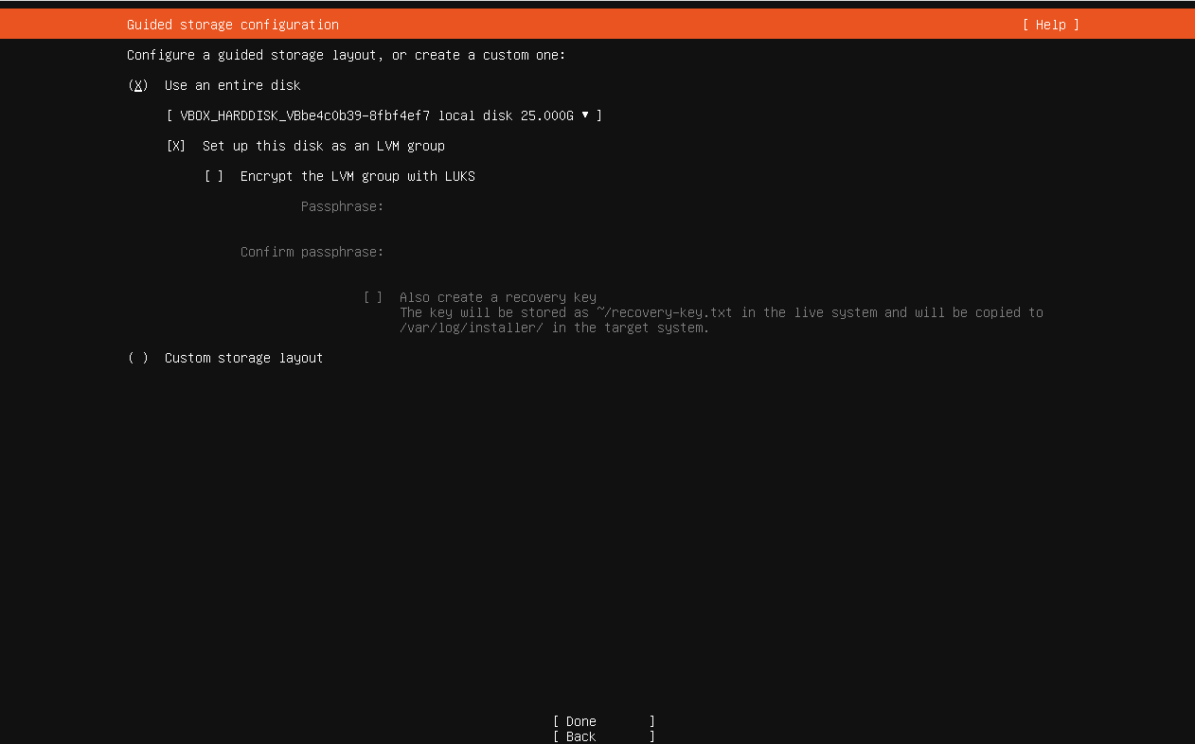
Part 1 setting up ubuntu Server
Here we have to specify the disk and how much of the disk we want to use, for a default config like ours we will just use the whole main disk

Slide 8
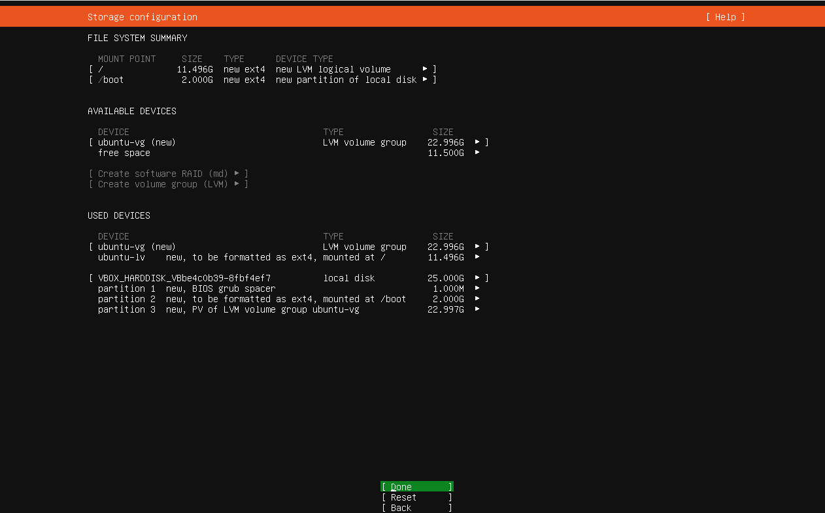
Part 1 setting up ubuntu Server
Here is a recap of every modification that will be applied to the disk

Slide 9
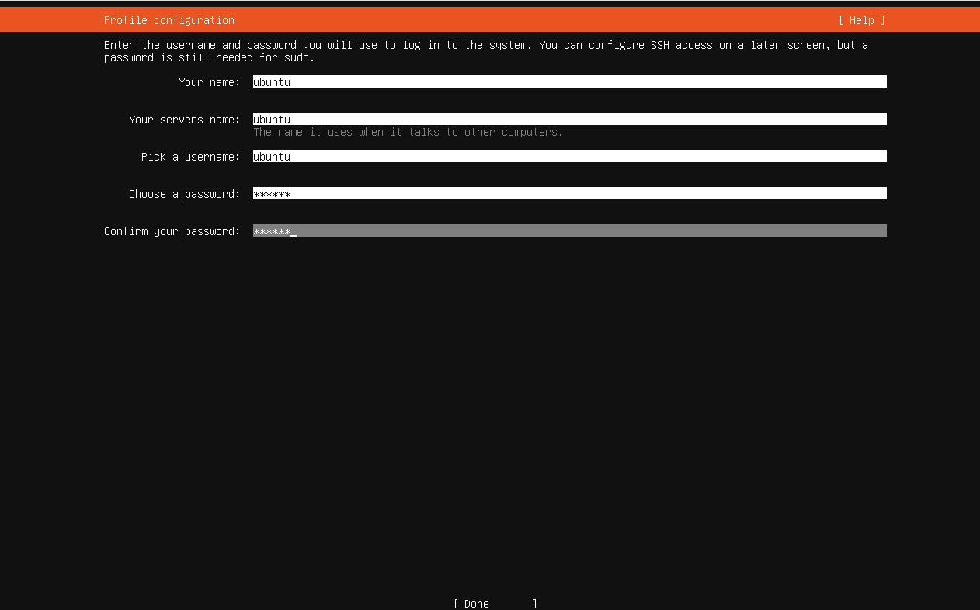
Part 1 setting up ubuntu Server
Here we enter our credential, the name of the account
The name of the computer seen from the network and the password of the account

Slide 10
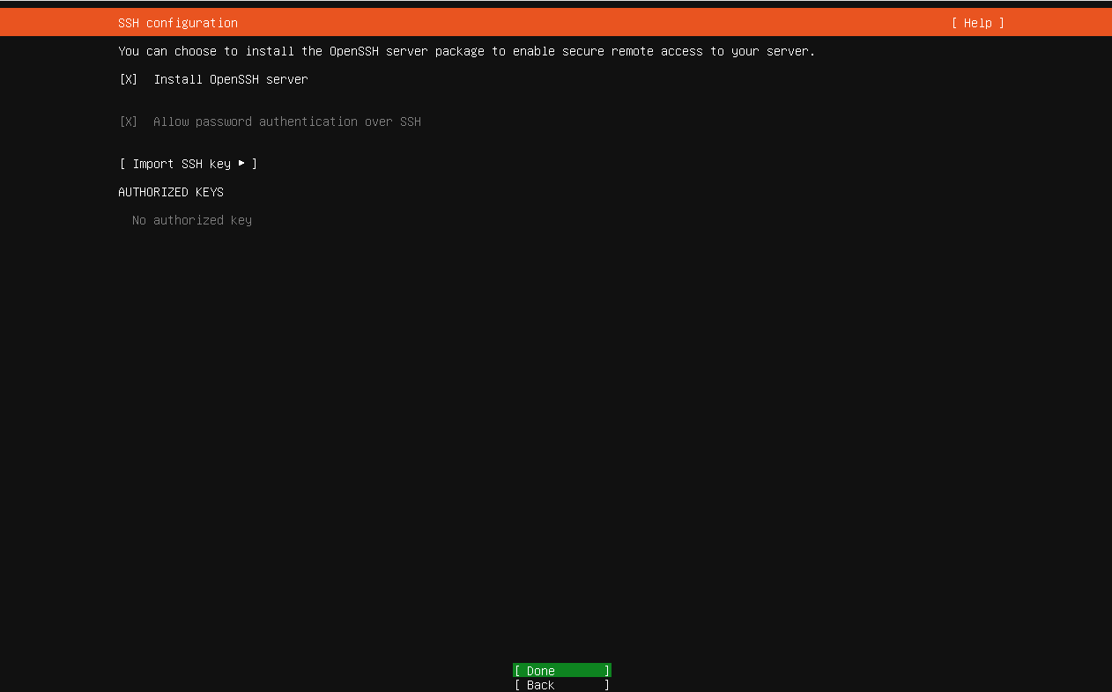
Part 1 setting up ubuntu Server
If we want to be able to access to our server remotely without a screen here we have to check install openSSH server

Slide 11
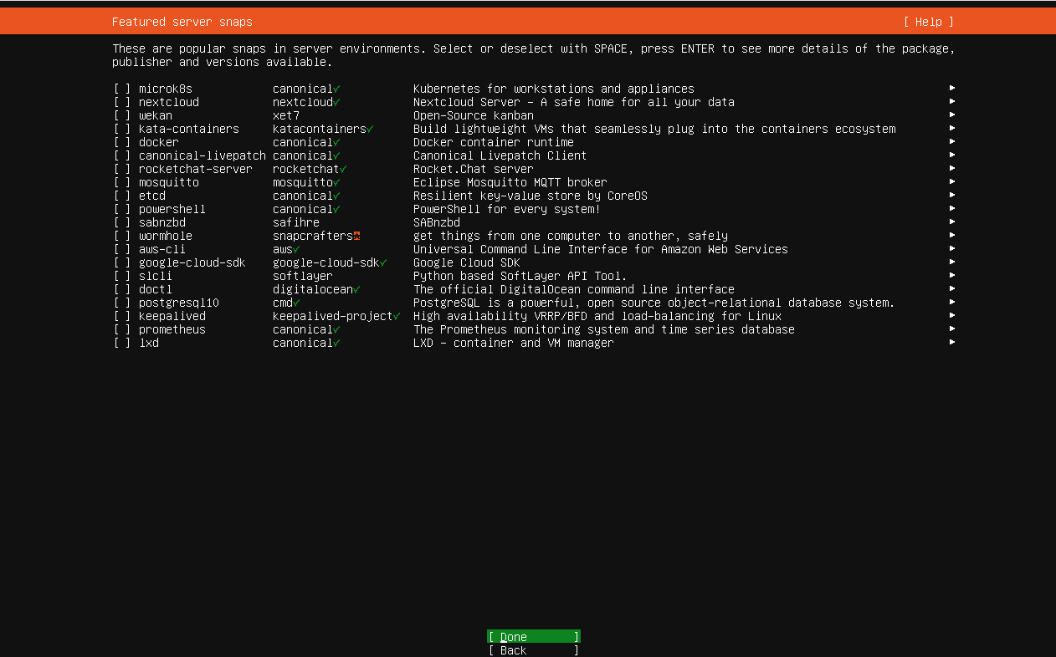
Part 1 setting up ubuntu Server
Here we select additional module if we need them

Slide 12
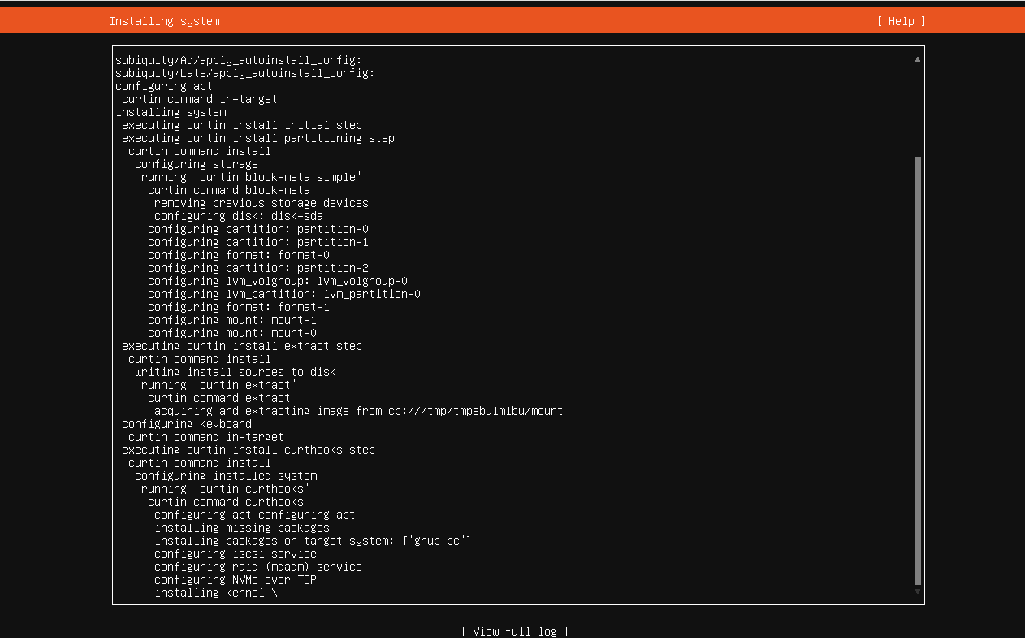
Part 1 setting up ubuntu Server
We will then arrive here, and from here we only have to wait until the installation is complete

Slide 13
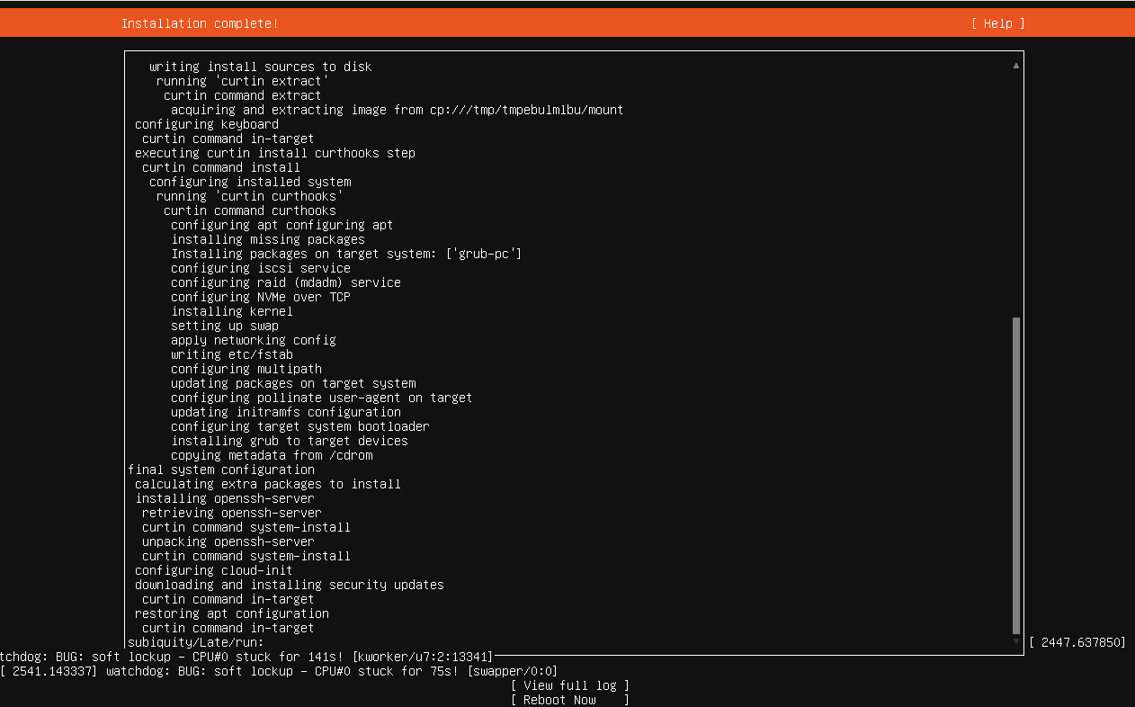
Part 1 setting up ubuntu Server
Now you just have to select reboot now on the bottom, the coputer will restart and automatically boot on ubuntu server
You will just have to enter your username and password

Slide 14
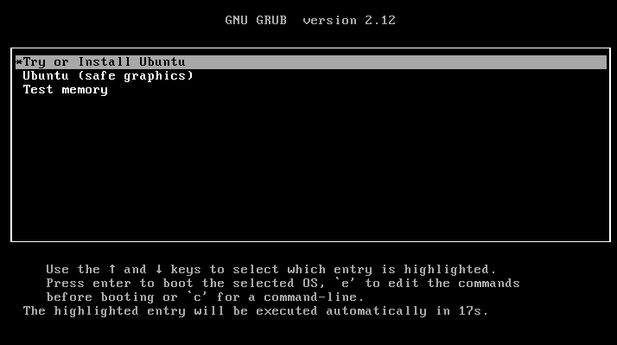
Part 2 setting up ubuntu Desktop
When we boot on ubuntu we arrive to this screen if we don't touch anything it will select Try or Install Ubuntu ( what we want ) by default

Slide 15
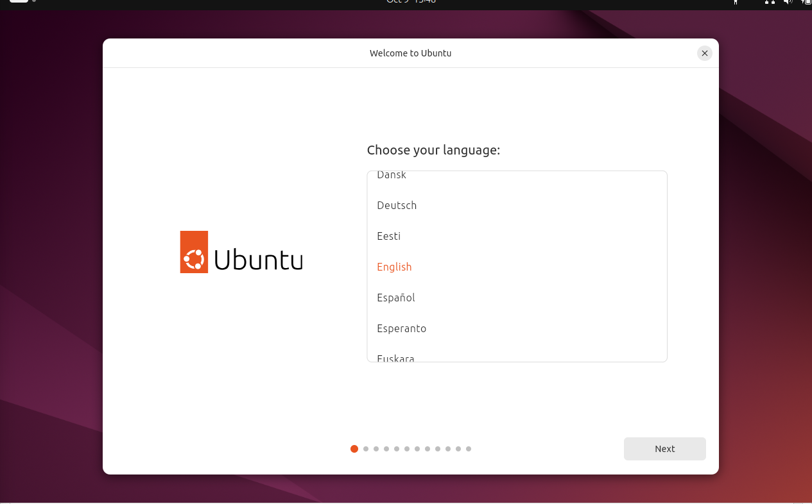
Part 2 setting up ubuntu Desktop
First we will select the language ( since it is a graphic interface we can use the mouse if we want )

Slide 16
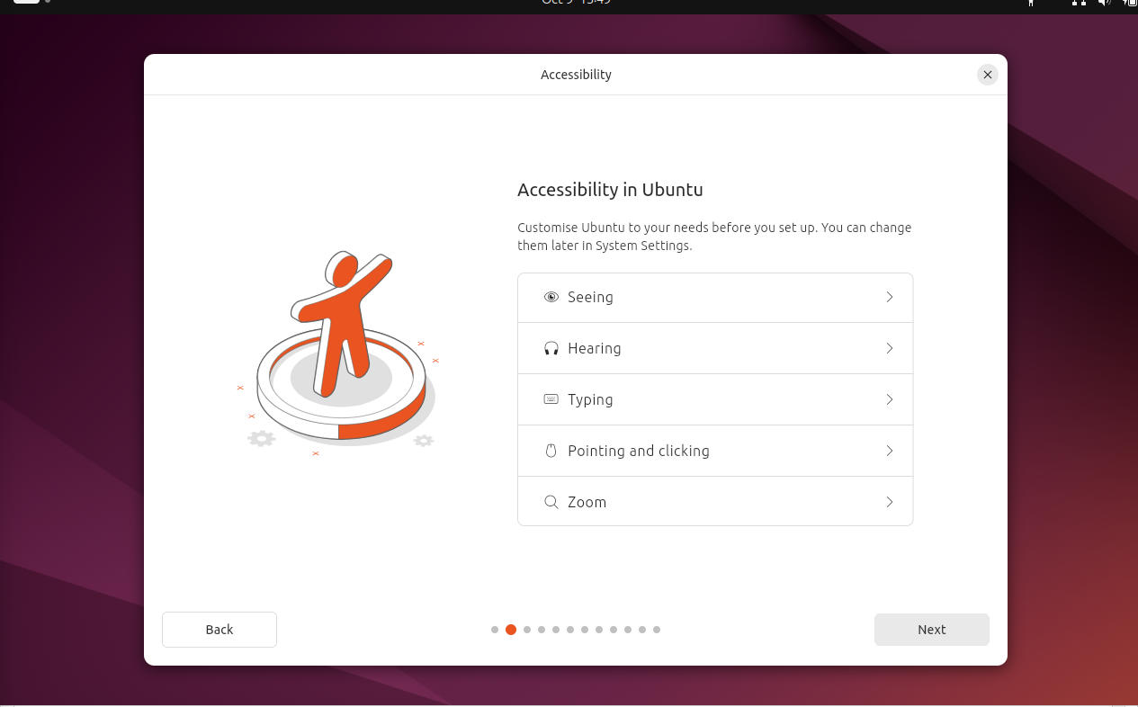
Part 2 setting up ubuntu Desktop
Here we will leave it by default since we don't have accessibility issues

Slide 17
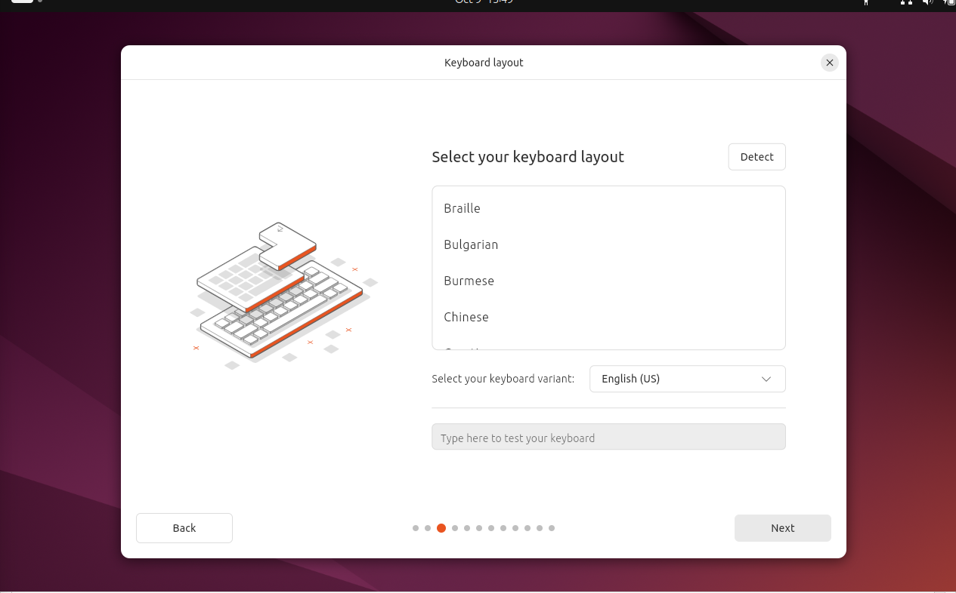
Part 2 setting up ubuntu Desktop
Here we will select the keyboard ( i will advise you to use the detect function )

Slide 18
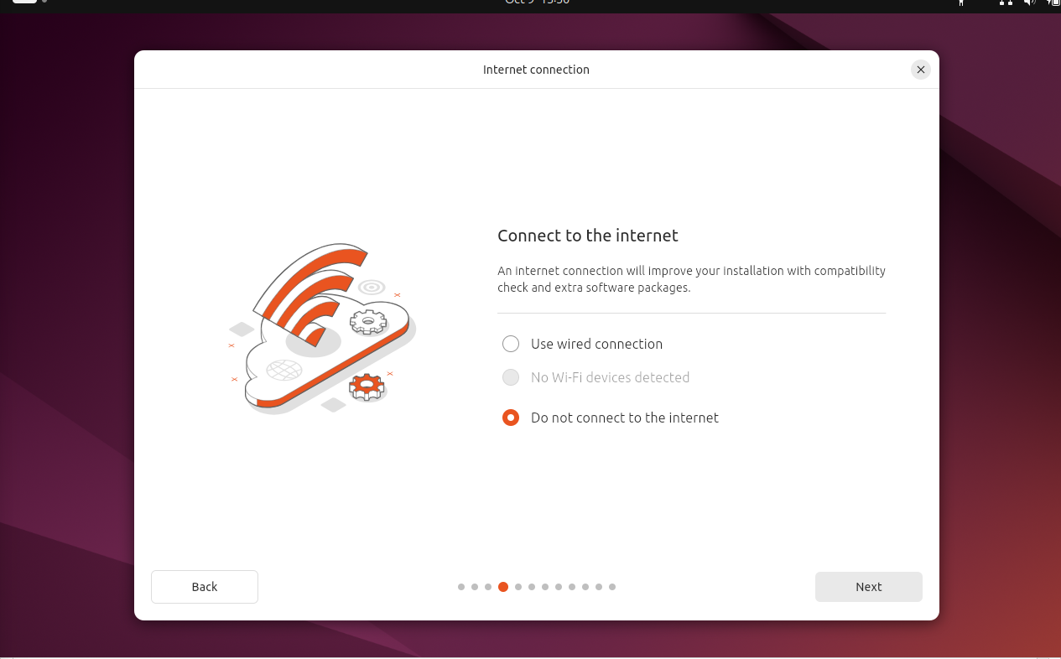
Part 2 setting up ubuntu Desktop
We setup the internet connexion ( to download missing driver for example )

Slide 19
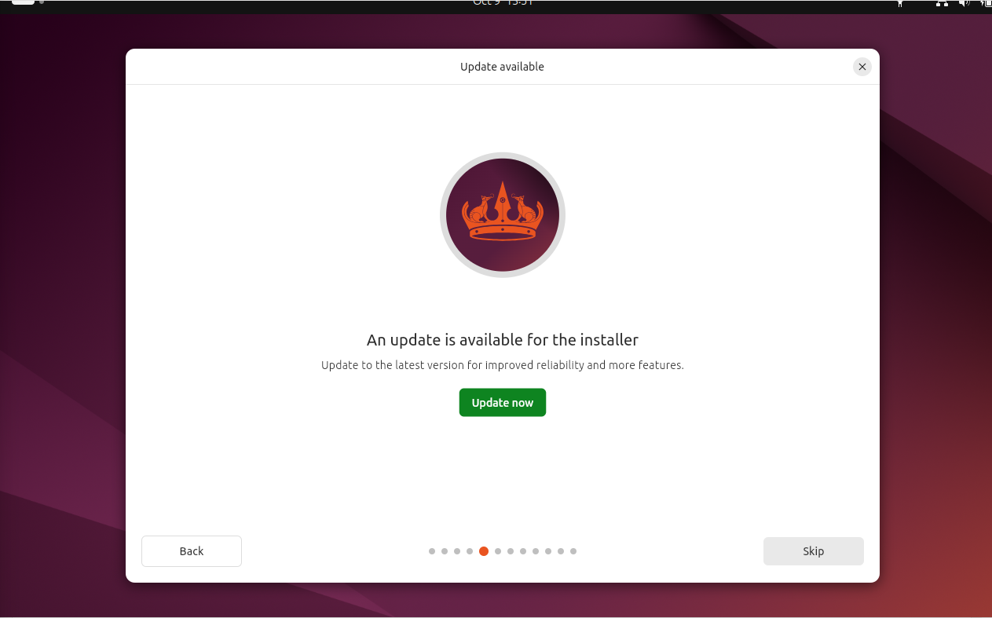
Part 2 setting up ubuntu Desktop
You will install the update in order to get a better compatibility, more secure and more stable version of ubuntu

Slide 20
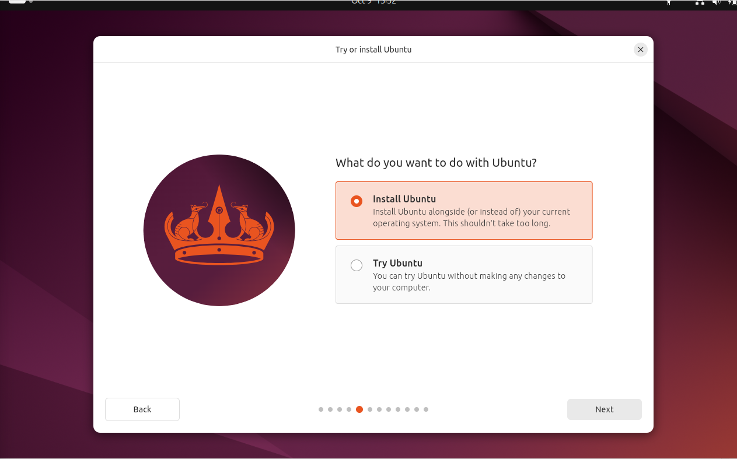
Part 2 setting up ubuntu Desktop
Here we will select install so the next time we boot our computer we don't have to do all of that all over again

Slide 21
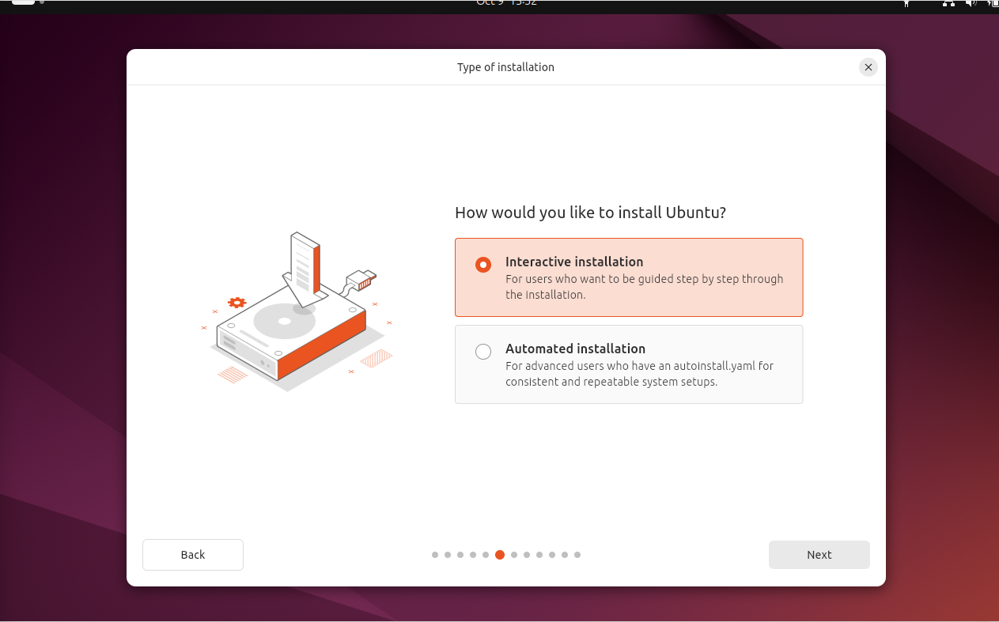
Part 2 setting up ubuntu Desktop
We will select interactive installation as it is easier and we don't need to partition our disk

Slide 22
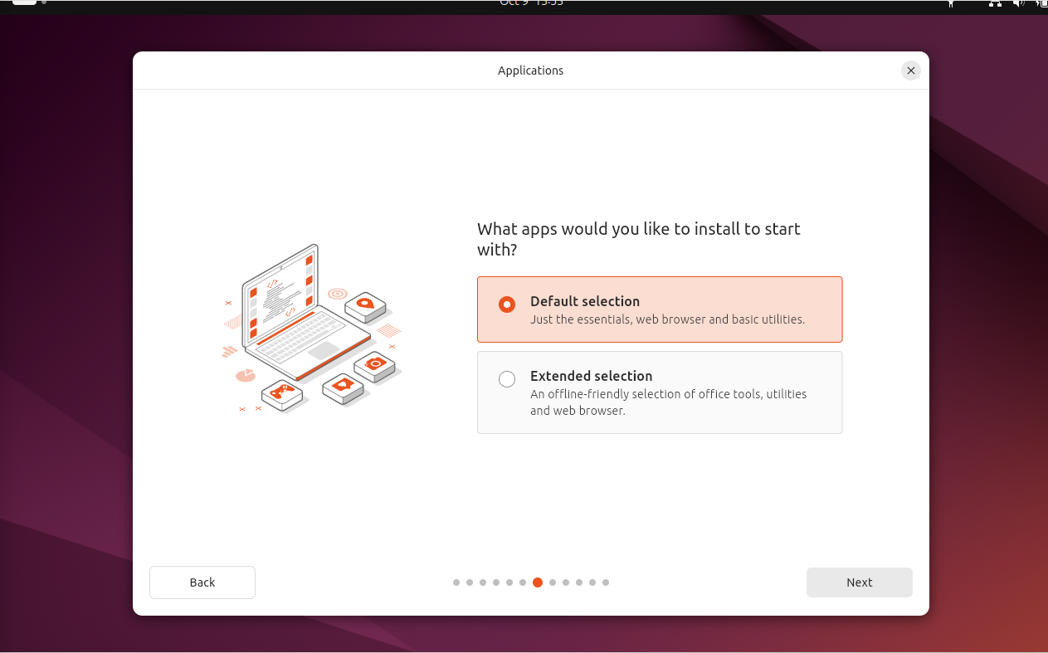
Part 2 setting up ubuntu Desktop
Here we also select default as we only need ubuntu desktop for testing we could still add more app later

Slide 23
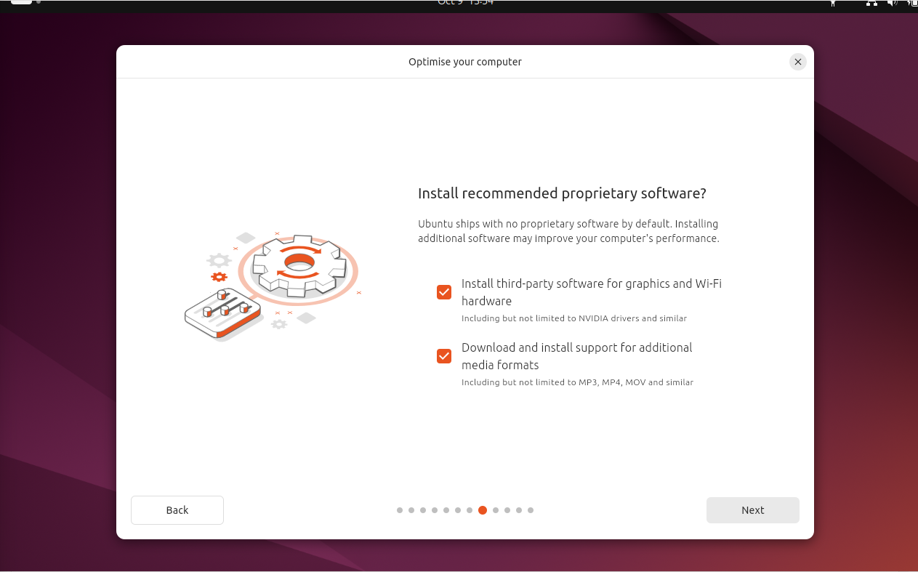
Part 2 setting up ubuntu Desktop
By default thoes two element are not checked i recommend you to check them

Slide 24
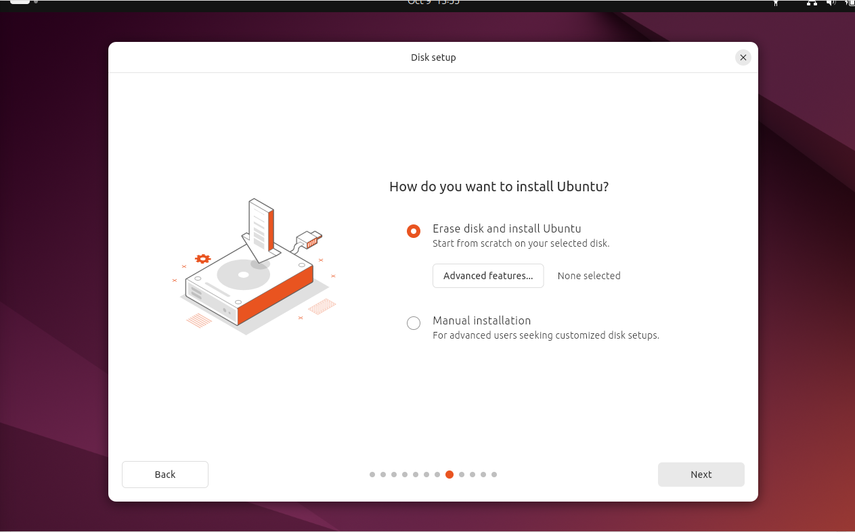
Part 2 setting up ubuntu Desktop
Same as before for simplicity we will use the whole disk

Slide 25
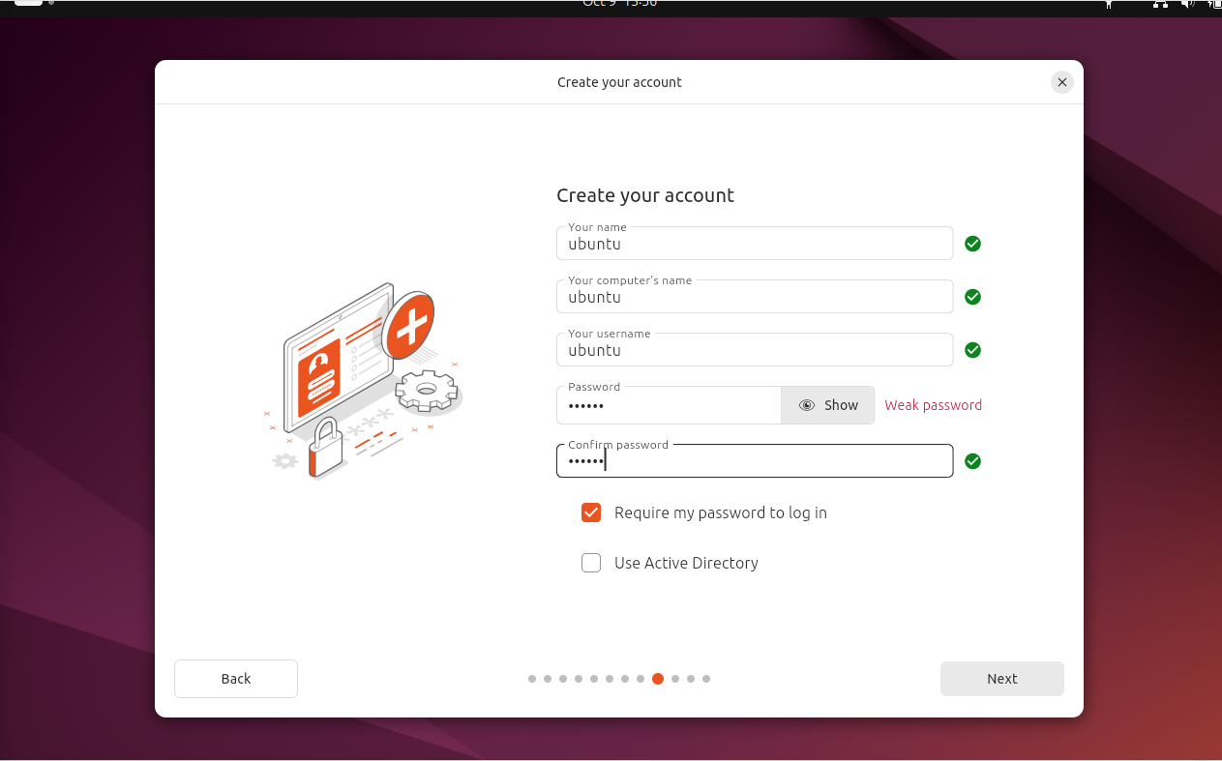
Part 2 setting up ubuntu Desktop
Here we enter our credential, the name of the account
The name of the computer seen from the network and the password of the account

Slide 26
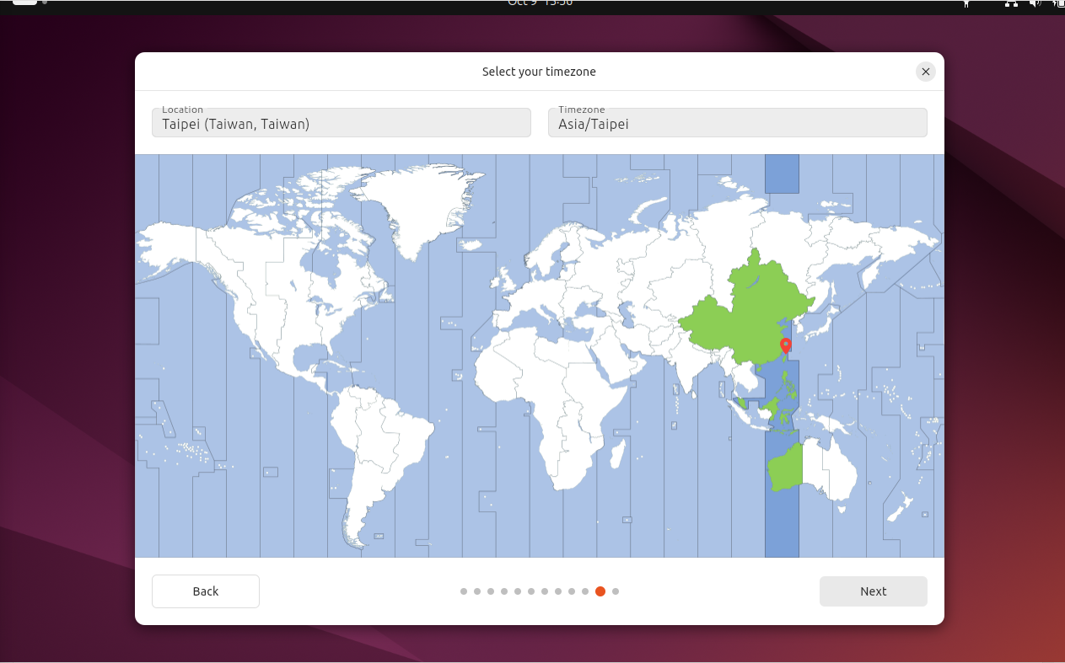
Part 2 setting up ubuntu Desktop
Here we select the time zone (use sometime for security) so the computer automatically know what time it is

Slide 27
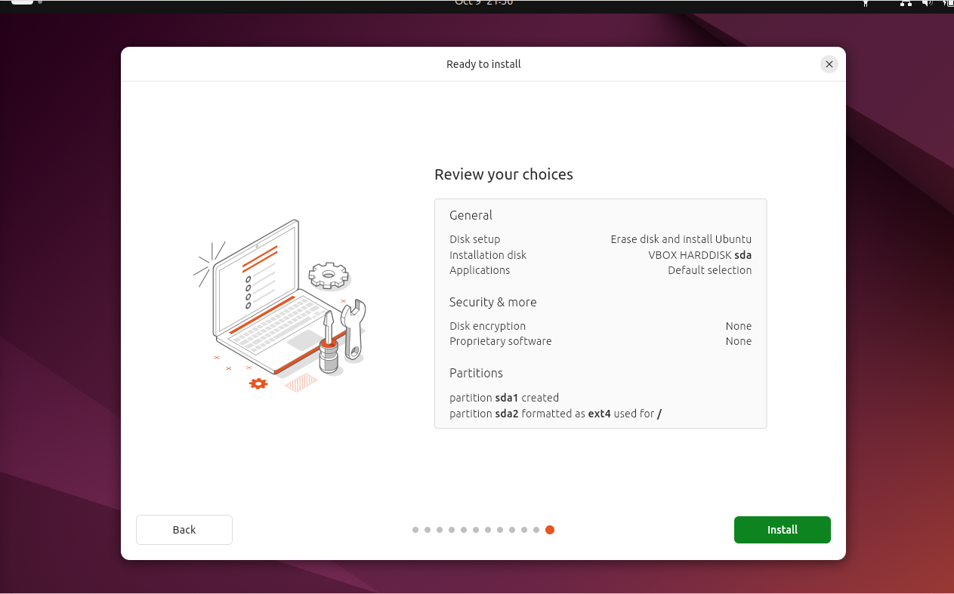
Part 2 setting up ubuntu Desktop
Now click on install and it will proceed with the instalation
Once it is done the computer will restart and you iwll be able to use Ubuntu Desktop

Slide 28
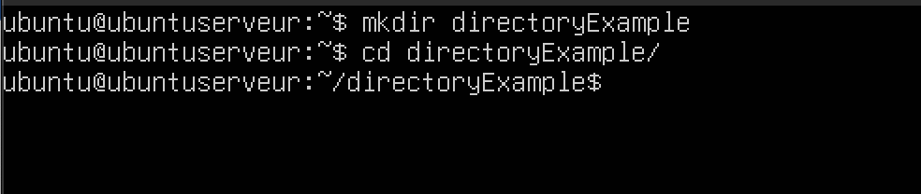
The command CD
Used to move between folder
Change the current directory
For example i was in the home ( represented by ~ ) and i moved to directoryExample

Slide 29
Commande : ls
Show files and folder in the current folder
For example in the current folder you see in white the files ( fileExample, fileExample2, fileExample3, fileExample4)
and in blue the folders : (subDirectoryExample, subDirectoryExample2, subDirectoryExample3, subDirectoryExample4 )

Slide 30
Commande : chown
Changes the owner of a file ( in the example i made ubuntu owner of fileExample2 )

Slide 31
Commande : rm
Used to delete a file
You can also delete a folder by adding the argument –r
In the example i delete the fileExample3 and between the first and last ls we see it disapear

Slide 32
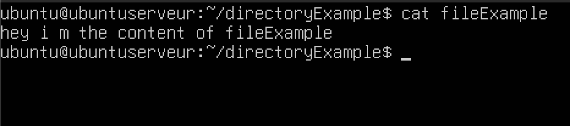
Commande : cat
Show the content of a file or joins the contents of multiples files
In this example the content of fileExample was : "hey i m the content of fileExample "

Slide 33
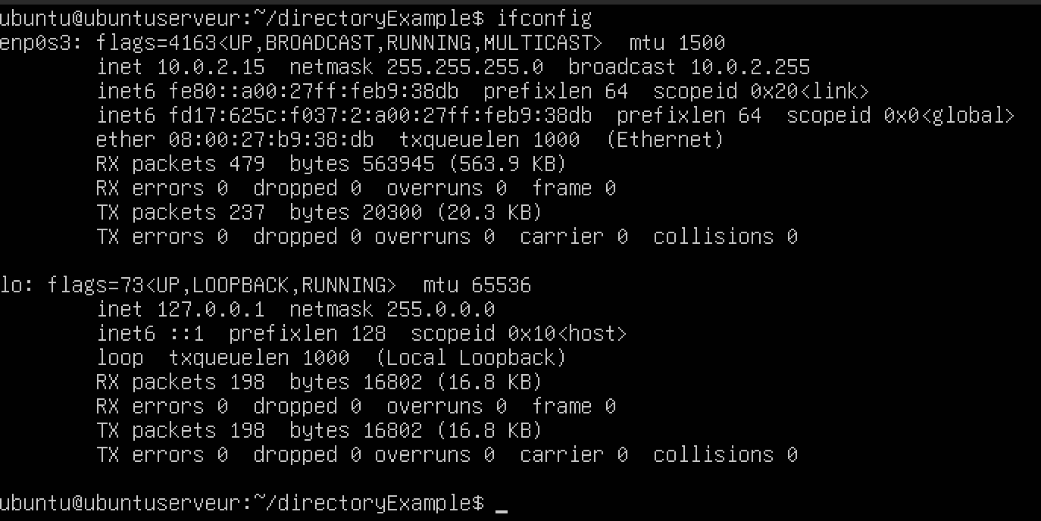
Commande : ifconfig
Display the network interface
( can also be used to configure them )

Slide 34
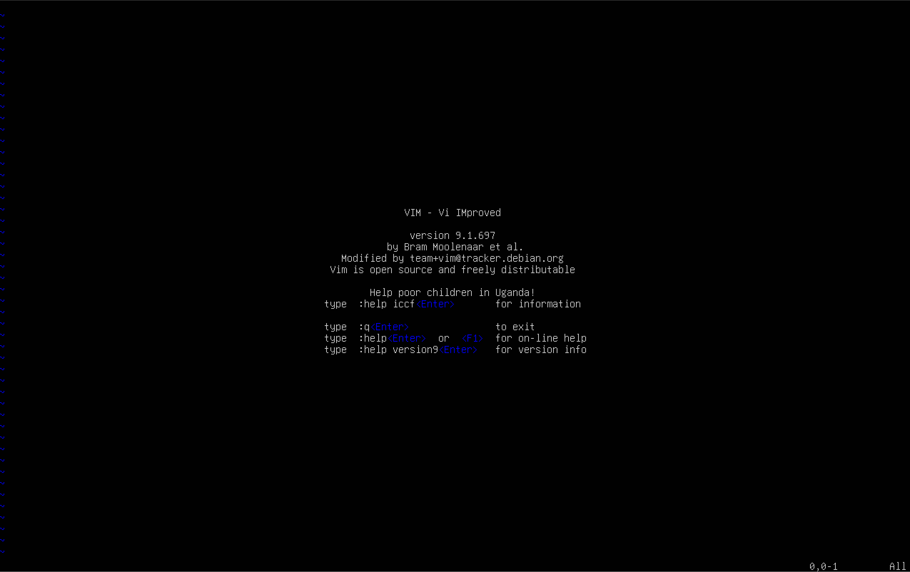
Commande : vi
Basic text editor
A bit complicated to use so i didn't really use it when I'm connected to my servers in ssh

Slide 35
Commande : vim
As hard to use as vi but is has more feature
this one is also bit complicated to use so i didn't really use it when I'm connected to my servers in ssh

Slide 36
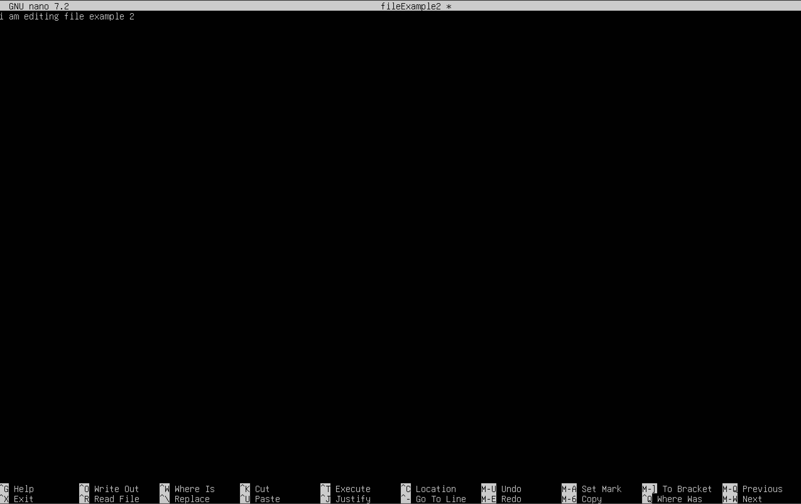
Commande : nano
My personnal favorite and the command i always use when i work on my server, it is a simple, fast, light and simple to use text editor

Slide 37
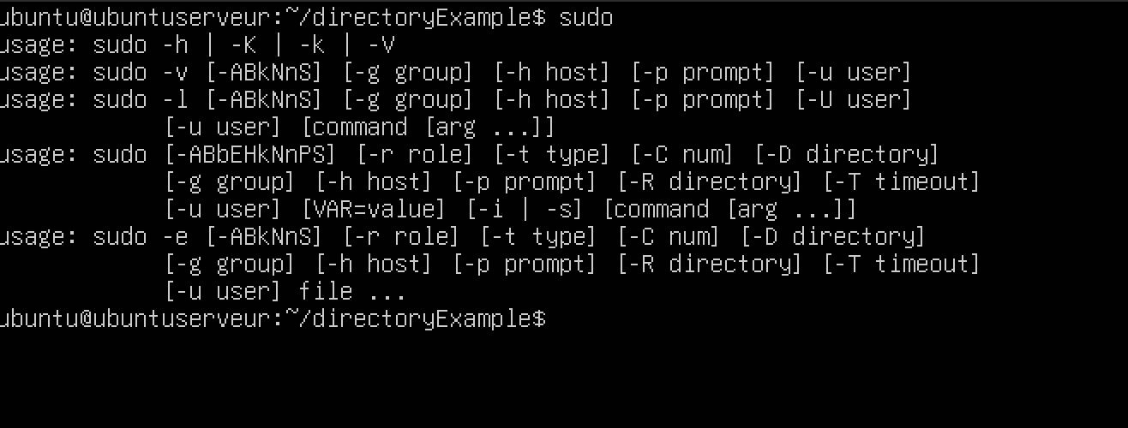
Commande : sudo
Sudo means Super User DO
Used to run command with root privileges

Slide 38
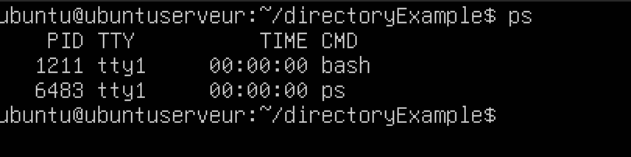
Commande : ps
Used to list the currently running process and their PID

Slide 39
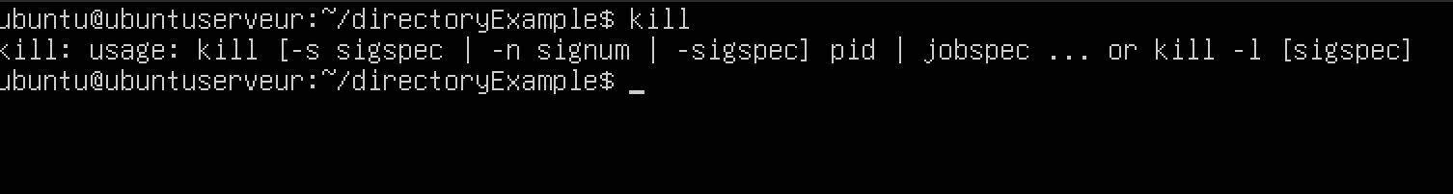
Commande : kill
Used to send signal to a programm ( usually to stop it )
To stop a programm using kill you have to use the –9 argument

Slide 40
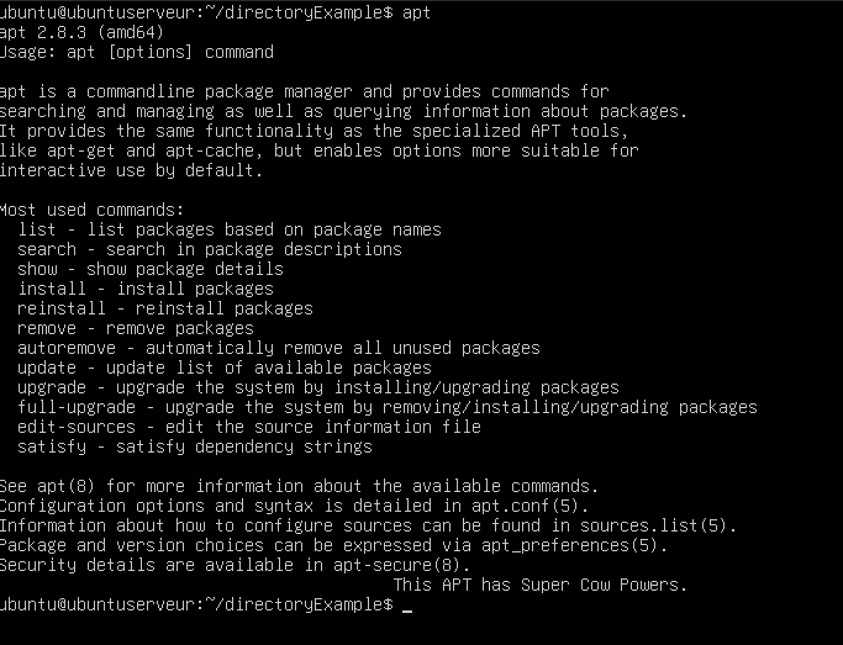
Commande : apt
Install, update and remove software
I had to use it to install net-tools to get the ifconfig command

Slide 41
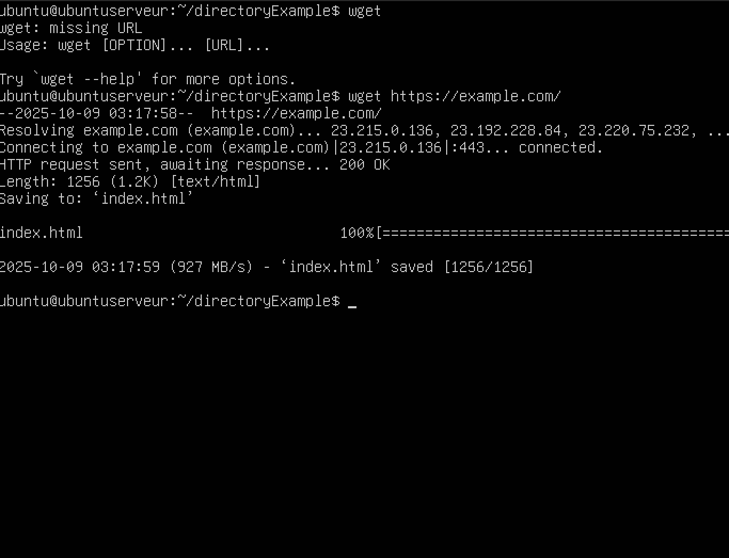
Commande : wget
Download files throught http / https ( a html page in my case )

Slide 42
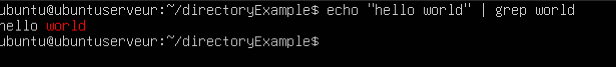
Commande : grep
Find matching patterns or word
In my case i echo "hello world" in grep and ask him to find the word "world"

Slide 43
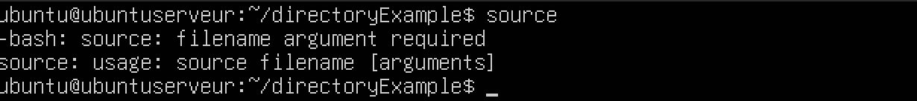
Commande : source
Execute a script in the current environnement ( doesn't create a new one or create a new shell )

Slide 44
Commande : service
Start and stop system services
I use it a lot with mongodb ( sudo systemctl status mongod )

